Slide 1
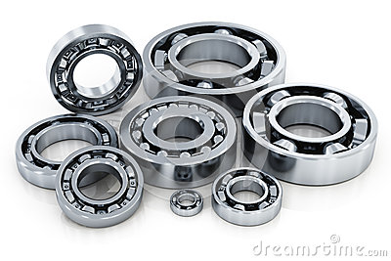

B E A R I N G S

Slide 2
8/1 The video task
http://www.youtube.com/watch?v=ONz6S48QgEk
The balls are made of a) steel b) iron c) wood
The water based liquid is there to a) wash the rings b) to cool the rings c) to prevent corrosion
The balls are a) made by cutting to small pieces from wires b) made by melting the steel and cooling it c) in a hollow mould
The balls are loaded to the rings a) automatically b) handmade c) in another workshop
At the end of the production there a) is only a man-made test b) are many quality tests done by various machines c) is no test as the production is high quality.

Slide 3
The answers
a) steel
b) to cool the rings
a) made by cutting to small pieces from wires
a) automatically
b) are many quality tests done by various machines

Slide 4
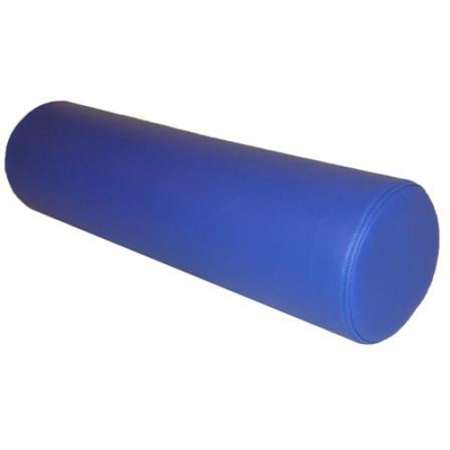
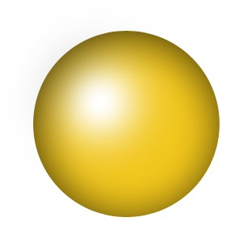
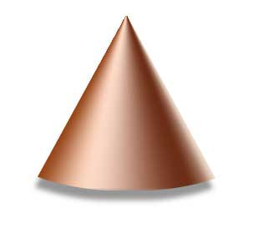
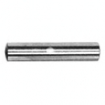
8/5 Find the shapes
c)
Ball * needle * roller * cone*
b)
a)
d)

Slide 5
Answers
cone
ball
roller
needle
8/2 Read and listen to the text.

Slide 6
8/3 Choose the correct term
lifetime* bearing* shaft* diameter * friction* motion* rotation*
podlouhlá rotační součást strojů
součást technického zařízení, které umožňuje ...
výrobku je doba, po kterou může být stoj používán
proces, při kterém pevná tělesa mění svoji …
jev, který vzniká při pohybu tělesa v těsném kontaktu...
otáčení pevného tělesa kolem své jedné osy
úsečka spojující dva body kružnice procházející středem

Slide 7

Answers
shaft
bearing
lifetime
motion
friction
rotation
diameter
diameter

Slide 8
8/4 Choose the correct term
lifetime* bearing* shaft* diameter * friction* motion* rotation*
the act of turning around the only axis ...
rubbing of one object or surface when ...
the action or process where a solid moves or changes ...
the long, narrow part a machine which holds ...
the period of time during which a machine …
a straight line passing from side to side through the centre …
is a machine element that constrains relative motion …

Slide 9
Answers
A bearing is a machine element ...
Motion the action or process ...
Rotation the act of turning around the only axis
Friction rubbing of one object or surface …
Shaft the long, narrow part a machine …
Diameter a straight line passing from side to side …
Lifetime the period of time during which …

Slide 10
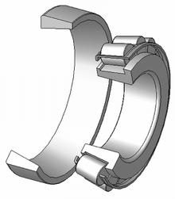
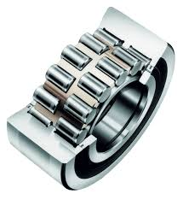
8/6 Double row or single row ?

Slide 11
Answers
a) Single row bearing b) Double row bearing

Slide 12
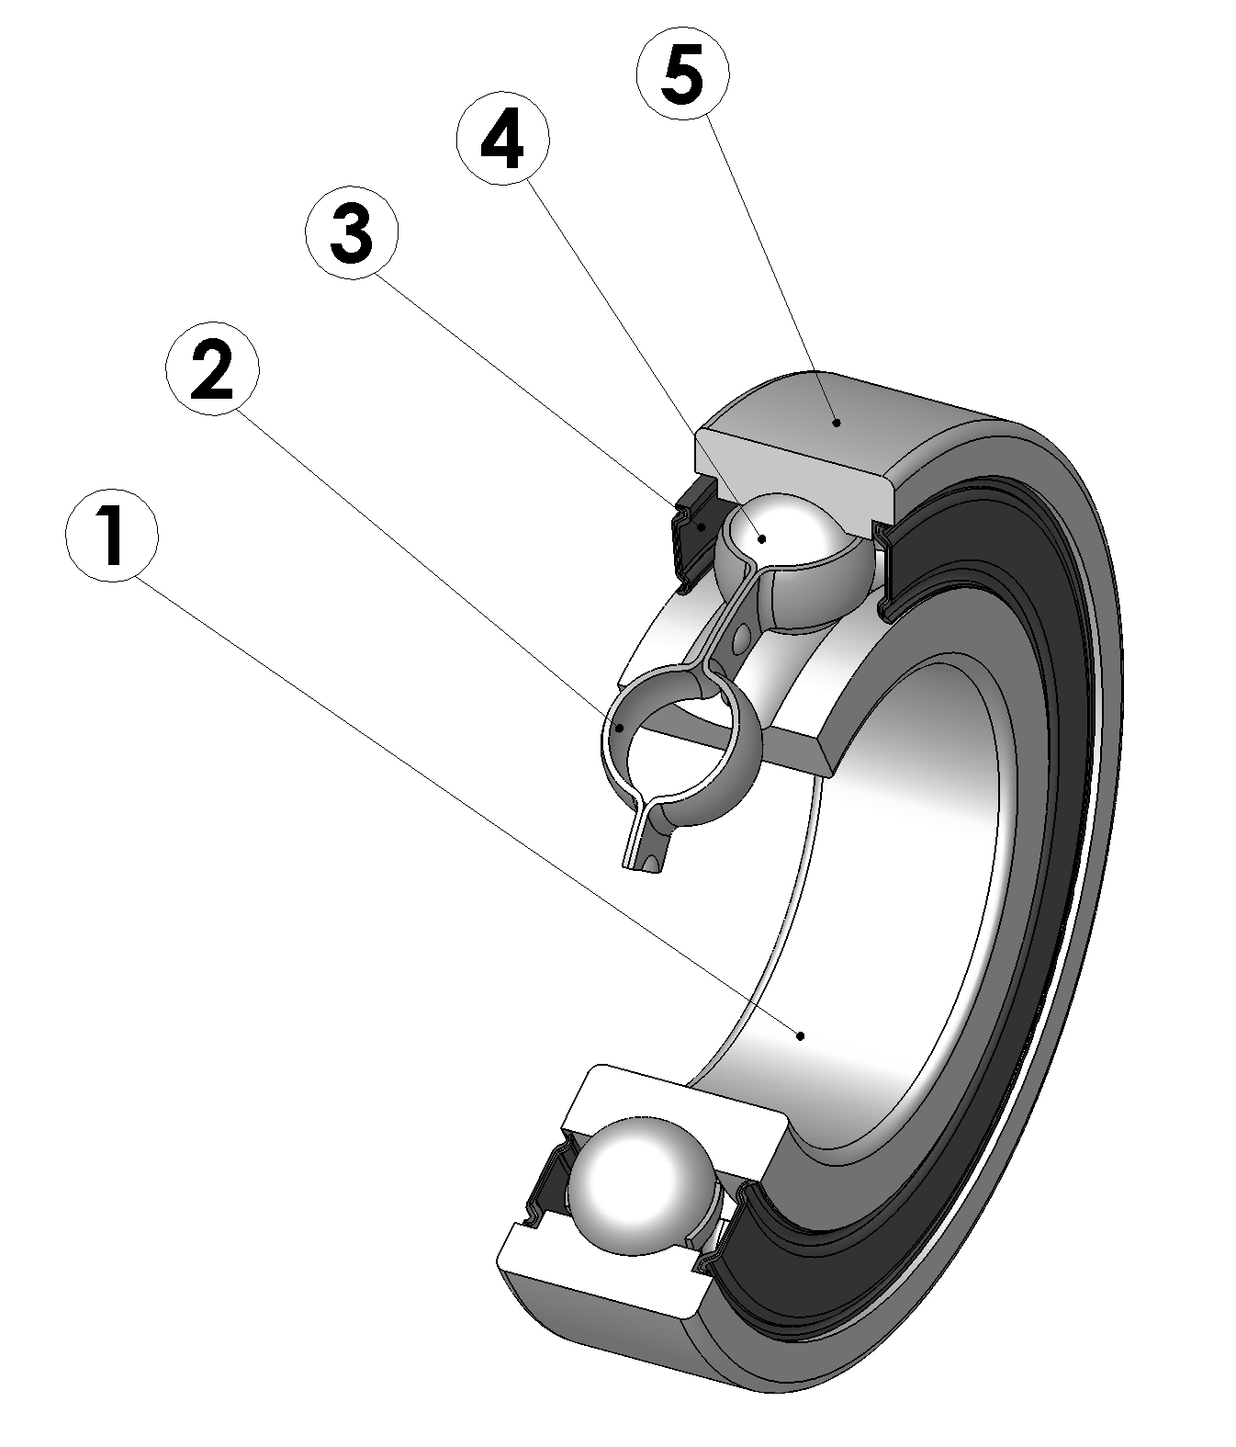
8/7 Name the parts
.
.
.
.
.

Slide 13
Answers
inner ring
ball cage
sealing ring
balls
outer ring

Slide 14
8/8 Work out a dictionary
Work out a dictionary for each bold expression in this unit.
Put it into alphabetical order
Find phonetic transcription
Write it into your text book

