Slide 1
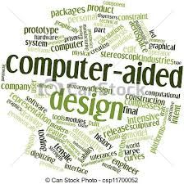

CAD designing

Slide 2
The video task
http://videos.autodesk.com/zencoder/content/dam/autodesk/www/solutions/simulation/videos/simulation-overview-video-896x504.mp4
7/1 Watch the video and answer the question:
What advanages can 3D designing and simulation bring in accordance to the video?

Slide 3
Answers
Possible answers:
Solving designing problems
Predicting how the product will perform and look like
Desings optimalization
Save costs before manufacturing
Details simulating
Better decisions

Slide 4
7/3 Choose the correct terms
computer-aided design* programs* visualize* three dimensions* to design* standards-based parts* tolerances* dimensions* angle*
allowed variation in distance or space for …
to make visible
instructions required by a computer to function
software is used by architects, engineers, drafters ...
the length, width, height, or depth of something
an object that has height, width and depth, …
to make detailed drawing or a plan
the difference between the direction of two lines…
parts for which technical criteria, specifications, …

Slide 5
Answers
tolerances allowed variation in distance …
visualize to make visible
programs instructions required by a computer to function
computer-aided design software is used by architects …
dimensions the length, width, height, or depth of …
three dimensions an object that has height, width …
to design to make detailed drawing or a plan
angle the difference between the direction of two …
standards-based parts parts for which technical …

Slide 6
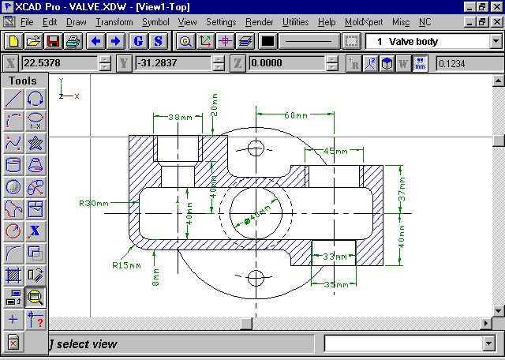
7/5 Describe some tools you use:

Slide 7
Answers
Possible answers:
I use this tool, (this button) to start drawing, to edit …, to change dimensions of …., to create an object …..
If I need the object to rotate I click on …..
I click on … to save my drawing, to change font size, to ….

Slide 8
7/4 Choose three definitions
Create designs* Save time and accelerate projects* Create presentations*
Eliminate redundant pencil and paper drawings
Explore ideas with 3D modelling tools
Complete projects with comprehensive tools
Digitize scanned drawings
Re-create as-built environments with point cloud tools
Translate third-party 3D file formats into DWG
Test form, fit, and function variations
Display renderings from AutoCAD designs
Cut rendering times with A360

Slide 9
Answers
Create designs
Eliminate redundant pencil and paper drawings
Explore ideas with 3D modelling tools
Complete projects with comprehensive tools
Save time and accelerate projects
Digitize scanned drawings
Re-create as-built environments with point cloud tools
Translate third-party 3D file formats into DWG
Create presentations
Test form, fit, and function variations
Display renderings from AutoCAD designs
Cut rendering times with A360

Slide 10
7/6 Work out the dictionary
Work out a dictionary for each bold expression in this unit.
Put it into alphabetical order
Find phonetic transcription
Write it into your text book

