Slide 1
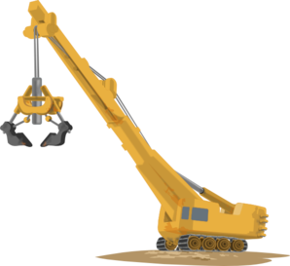
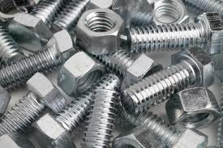

Screw joints
and assembly

Slide 2
The video task
1/1 Check the pronunciation before you watch. Watch the video and put the tool names into the order you see them.
https://www.youtube.com/watch?v=XAqmd8ScIQ4
screwdriver* battery screwdriver* tool box* safety gloves* hammer* safety glasses* knives* tape measure* pliers* levels*

Slide 3
Answers
battery screwdriver
screwdriver
safety gloves
safety glasses
hammer
pliers
tape measure
knives
levels
tool box

Slide 4
Listening and reading task
1/2 Read and listen to the following text:
1/3Find the terms to the following definitions
centre* disassemble* insert* fix* slot* sealing ring* bolt* mount on* assemble
a) Umístit součásti tak, aby byly ve středu jiné součásti
b) Vložit součást do jiné součásti nebo mezi dvě součásti
c) Kovový spojovací prvek, jehož hlavní částí je závit a doplňkovou součástí je matice
d) Umístit nebo upevnit součást ve správné poloze na jiné součásti
e) Sestavit jednotlivé součásti do hotového výrobku
f) Kroužek nebo proužek materiálu, který zajišťuje těsnost spoje
g) Dlouhá úzká štěrbina, do které se vsunují či jinak montují součásti
h) Pevně umístit součást tak, aby se nehýbala
i) Rozebrat jednotlivé součásti hotového výrobku na součástky

Slide 5
Answers
centre* Umístit součásti tak, …..
insert* Vložit součást do….
bolt* Kovový spojovací prvek, …
mount on* Umístit nebo upevnit …..
assemble* Sestavit jednotlivé….
sealing ring * Kroužek nebo proužek….
slot* Dlouhá úzká štěrbina, ….
fix* Pevně umístit součást tak, …..
disassemble* Rozebrat jednotlivé ….

Slide 6
1/3 Find the terms to the definitions
centre* disassemble* insert* fix* slot* sealing ring* bolt* mount on*assemble*
A ring or strip of material that ensures the tightness of a joint
To place or attach a component onto another one in proper position
A long narrow opening into which a component is put
To place a component inside another component or between two components
To take apart a machine so that it is again in separate components
To move a component so that it is in the centre of something else
A type of fastener characterised by an external thread, used together with a nut
To put individual components together into one finished product
To put a component firmly in a designated place so that it will not move

Slide 7
Answers
sealing ring* A ring or strip of material ….
mount on* To place or attach a ….
slot* A long narrow opening ….
insert* To place a component inside another ….
disassemble* To take apart a machine ….
centre* To move a component so that it ….
bolt* A type of fastener characterised by ….
Assemble* To put individual components ….
fix* To put a component firmly in a ….

Slide 8
1/5 Sort the expressions to the right column
bolt* assemble* vice* nail* Allen key* screw* mount on* disassemble* nuts* bolts* adjustable* spanner* insert* rivet* fix* hammer* centre* screw* sealing rings* pin* spanner* pliers
Verbs Fasteners Tools

Slide 9
Answers
Verbs Fasteners Tools
assemble bolt vice
Disassemble sealing rings hammer
mount on nuts Allen key
insert pin adjustable spanner
fix rivet, nail a screw
centre bolts. spanner
screw pliers

Slide 10
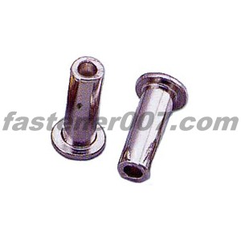
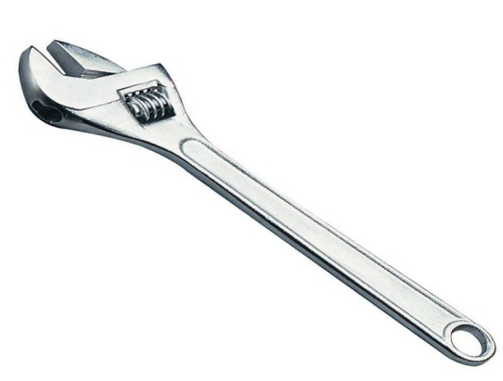
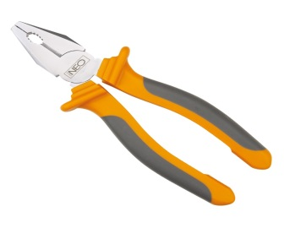
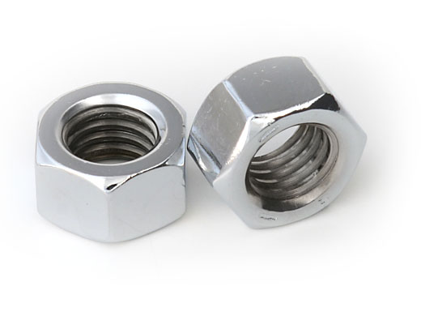
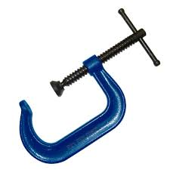
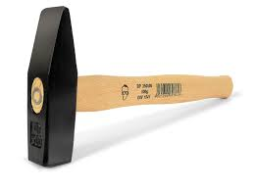
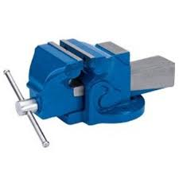
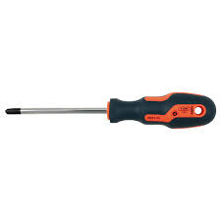
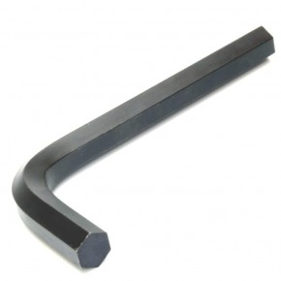
1/6 Match the tool names with the pictures
2
3
1
5
4
6
8
9
7

Slide 11
Answers
1 pliers
2 rivet/pin
3 adjustable spanner
4 clamps
5 nuts
6 hammer
7 screw driver
8 Allen key
9 vice

Slide 12
1/7 Work out the dictionary
Work out a dictionary for each bold expression in this unit.
Put it into alphabetical order
Find phonetic transcription
Write it into your text book

