Slide 1

MAcroeconomics

Slide 2
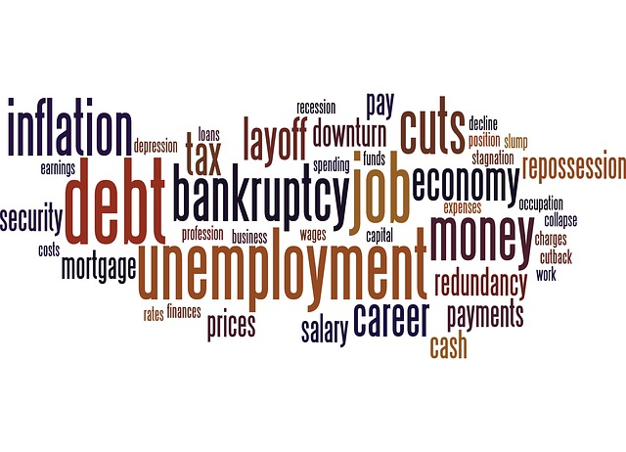
DEFINITION
Macroeconomics a branch of economics dealing with the performance, structure, behavior, and decision-making of an economy as a whole, rather than individual markets.
The word is of Greek
origin: makro – meaning
„large" and economics

Slide 3
WHAT DOES MACROECONOMICS STUDY?
GDP
Inflation
Unemployment
Foreign trade
Exchange rate
Aggregate supply
Aggregate demand

Slide 4
NATIONAL ECONOMY
= refers to a country's financial resources
Every national economy has some stages of development so-called economic cycle with four levels:
  Expansion
  Peak
  Recession
  Trough
PEAK
RECESSION
EXPANSION
TROUGH

Slide 5
GDP
= gross domestic product
GDP is the market value of all final goods and services produced within a country in a year.
We distinguish GDP and GDP per capita

Slide 6

GDP PER CAPITA
is often used as an indicator of a country's material standard of living.
The states with the highest GDP per capita:
Quatar
Luxembourg
Singapore
Norway
Brunei Darussalam
HongKong
U.S.A.
United Arab Emirates
Switzerland
Australia

Slide 7
INFLATION
459,- Kč
548,-Kč
= increasing price level of all goods and services over a longer period
We distinguish 3 types of inflation:
Moderate (low) inflation
Galloping inflation
Hyperinflation
$1000
$1890
45 €
52 €
£1,2
£2,1

Slide 8

UNEMPLOYMENT
Unemployment occurs when people are without work and actively seeking work.
We distinguish some types of unemployment:
Frictional
Structural
Cyclical
Seasonal
LOOKING FOR A JOB

Slide 9
UNEMPLOYMENT
Frictional unemployment (short-term) – is very natural, it´s a situation when people are looking for a job and they mostly find it quickly (after graduating from school, after moving)
Structural unemployment – it appears when some sectors (or geographic area) gets into a stronger downturn

Slide 10
UNEMPLOYMENT
Cyclical unemployment - based on the economic cycle in a period of recession and trough
Seasonal unemployment - is regularly in some sectors (agriculture, tourism)

Slide 11

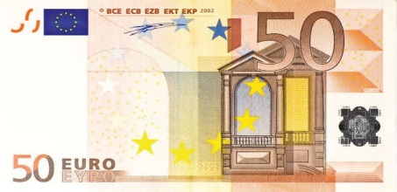




TAXES
= mandatory payment in the public bugdet
Individuals and legal entities pay different taxes.
STATE ☹
FOR ME ☺

Slide 12
TYPES OF TAXES
Income taxes
Property tax
VAT (Value added tax)
Consumer taxes

Slide 13
Resources:
http://www.ask.com/question/what-is-national-economy
http://www.dummies.com/how-to/content/tracking-the-economic-cycle-from-expansion-to-rece.html
http://en.wikipedia.org/wiki/Gross_domestic_product
http://www.mapsofworld.com/world-top-ten/world-top-ten-gross-domestic-countries-map.html
www.pixabay.com

