Slide 1

Microeconomics

Slide 2
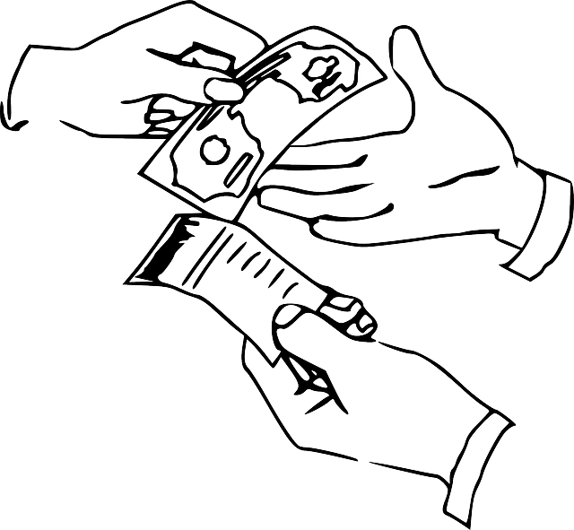
DEFINITION
Microeconomics a branch of economics that studies the behaviour of individuals and small impacting organizations in making decisions on the allocation of limited resources.
The word is of Greek origin: mikro - meaning "small" and economics

Slide 3
THE OBJECT OF INVESTIGATION
Deciding individual market participants:
  Individuals / households
  Companies
  State
How these decisions and behaviours affect the supply and the demand for goods and services

Slide 4
THE BASIC GRAPH
PRICE
DEMAND
SUPPLY
P*
EQUILIBRIUM
Q*
QUANTITY
P* - equilibrium price, Q* - equilibrium quantity

Slide 5
THE DEMAND
= the quantity of goods that buyers are willing to buy at that price.
The costumers want
to buy a larger quantity
at a lower price.
When the price increases
the demand decreases.
PRICE
DEMAND
QUANTITY

Slide 6
THE SUPPLY
= the quantity of goods sold that the company wants to sell at that price.
The companies want
to sell a larger quantity
at a higher price.
When the price increases
the supply increases too.
PRICE
SUPPLY
QUANTITY

Slide 7
THE ELASTICITY OF DEMAND
Elastic demand - significantly and rapidly responds to changes in prices
  Expendable and easily replaceable goods (fashionable goods, one type of pastry)
Inelastic demand – responds to changes in prices slowly and limited
  Goods and services which we need for life and we can not replace it (salt, fresh water)

Slide 8
THE ELASTICITY OF SUPPLY
The supply is usually increasing. So it´s usually elastic.
The inelastic supply is not often. We can find inelastic supply in a short period.

Slide 9
Resources:
http://en.wikipedia.org/wiki/Microeconomics
http://cs.wikipedia.org/wiki/Mikroekonomie

