Slide 1

MAnagement

Slide 2

WHAT´S MANAGEMENT?
Business discipline
Human activity in a company
Theoretical science
Ability to manage a company

Slide 3
WHO IS A MANAGER?
= a person who manages something or somebody
Manager´s basic tasks:
Responsibility for other people´s work
Planning the work
Allocating the resources
Control

Slide 4
MANAGEMENT FUNCTIONS
Planning
Organizing
Staffing
Leading
Controlling

Slide 5

PLANNING
= how to achieve a particular goal

Slide 6
TYPES OF PLANES
According to time:
  Long-term plan (5 and more years)
  Medium-term plan (1-5 years)
  Short-term plan (up to 1 year)
According to control:
  Strategic plan
  Tactical plan
  Operational plan
  According to area management – e.g. Production plan, staffing plan, financial plan …

Slide 7
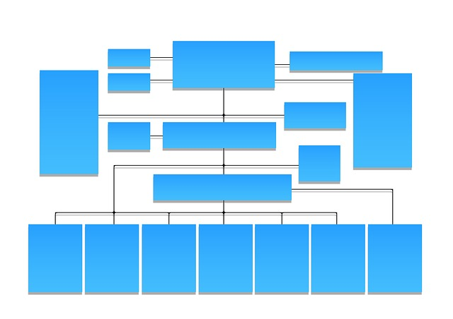
ORGANIZING
= assigning work and granting authority
The goal is to design an organizational structure
Types of organizational structures:
  Functional structure
  Divisional structure
  matrix

Slide 8
STAFFING
= includes human resources planning and working with employees
The company have to find people with:
  Right skills
  Knowledge
  Abilities to be the right employee on the right place.

Slide 9

STAFFING
It includes a lot of work with employees:
Recruiting
Selecting
Training
Developing
Educating
Etc.

Slide 10
LEADING
= The company needs to do more than just plan, organize, and staff to achieve a goal. The managers must also lead.
It involves:
Motivating
Communicating
Guiding
encouraging

Slide 11

CONTROLLING
It includes:
Establishing benchmarks or standards
Comparing actual performance against standards
Treatment of unwanted

Slide 12
TYPES OF CONTROL
According to time:
  Feedforward control
  Concurrent control
  Feedback control
According to duration:
  Continuous
  Regular
  Irregular
Partial control or complex control

Slide 13
Resources:
http://www.cliffsnotes.com/more-subjects/principles-of-management/the-nature-of-management/functions-of-managers
http://education-portal.com/academy/lesson/types-of-planning-strategic-tactical-operational-contingency-planning.html#lesson
http://smallbusiness.chron.com/different-types-organizational-structure-723.html
http://www.cliffsnotes.com/more-subjects/principles-of-management/staffing-and-human-resource-management/staffing-as-a-management-function
www.pixabay.com

