Slide 1

THE PRODUCT

Slide 2
MARKETING MIX
The product is one of the four elements of the marketing mix.
PRICE
PLACE
PRODUCT
PROMO-TION
MARKETING MIX

Slide 3
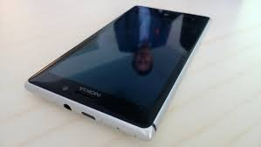
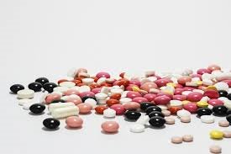

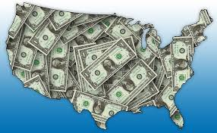
WHAT CAN BE A PRODUCT IN MARKETING?
= it´s all that can be sold, offered or exchanged
= it isn´t just material thing (car, toothbrush, oranges, house), but it can also be immaterial thing (idea, know-how, licence).

Slide 4
TYPES OF PRODUCT
  Types of product:
    tangible - physical goods, such as food or TV
    non-tangible - non-physical service, a medical examination etc.
  Division by type of customer:
    products for consumers
    products for companies

Slide 5









PRODUCTS FOR CONSUMERS
  Fast Moving Consumer Goods (FMCG)
  Durables
  Service

Slide 6
PRODUCTS FOR COMPANIES
  Material and components – wood, watter, oil, screws
  The products which companies use for production, but these products aren´t processed – buildings, machines, cars
  Supplies and services

Slide 7
BUILDING PRODUCT BENEFITS
Philip Kotler suggested that a product should be viewed on three levels.
total product + guarantee and after sales
AUGMENTED PRODUCT
core function + branding, packaging, features, e.g. telephone Nokia with camera and GPS in a green box
TOTAL PRODUCT
CORE PRODUCT
core function, e.g. telephone

Slide 8
DECISIONS ABOUT NEW PRODUCTS
If company wants to produce a new product it must decide on some facts:
Utility of the product
Brand
Marking
Packaging
After-sales service

Slide 9
UTILITY OF THE PRODUCT
Quality
Technical specifications
Design

Slide 10



BRAND
It´s a name, a sign, a symbol, a phrase or combination of the above.
It identifies the product.
Das Auto.

Slide 11
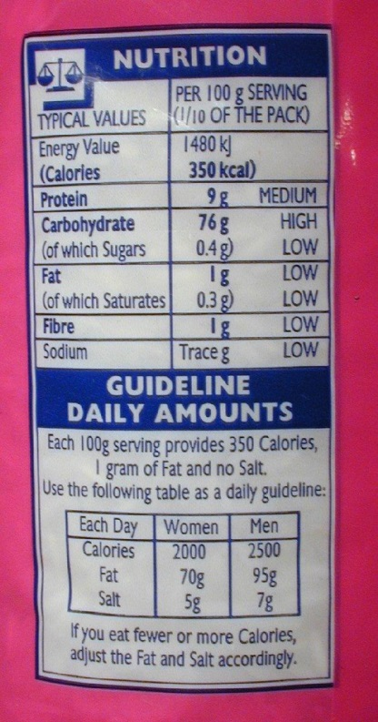

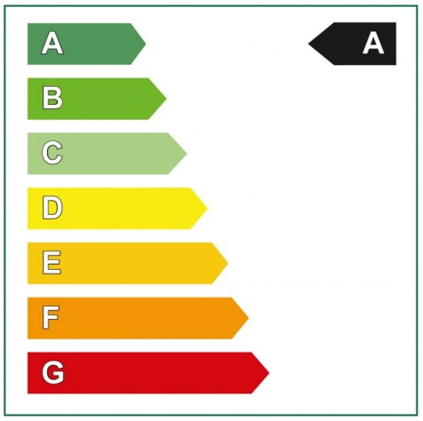

MARKING
Product marking gives seller and buyer information about the characteristics of the product. These could be made by symbols, pictograms, graphics, logos, text or numbers.

Slide 12
PRODUCT LIFE CYCLE
The product life cycle looks at the sales of a product over time
4
3
5
SALES
2
1
TIME

Slide 13
PRODUCT LIFE CYCLE
It consist of 6 stages:
Development
Introduction (part 1 in previous picture)
Growth (part 2 in previous picture)
Maturity (part 3 in previous picture)
Saturation (part 4 in previous picture)
Decline (part 5 in previous picture)

Slide 14
STAGES OF PRODUCT LIFE CYCLE
Development of the product – no sales and high costs
Introduction – low sales, high costs on promotion
Growth – sales increase, high costs
Maturity – sales stabilise, less costs on promotion, high profit
Saturation – sales begin to slow down, high profit, it´s important to find new or alternative product
Decline – sales decline, profit slow down, the product can be withdrawn

Slide 15
DIFFERENT TYPES OF PRODUCT LIFE CYCLE
CLASSICAL TYPE
FAILED PRODUCT
FANCY ARTICLES
FAVOURITE RETRO PRODUCTS

Slide 16
Resources:
http://businesscasestudies.co.uk/business-theory/marketing/product.html#axzz33J6qVt55
http://www.learnmarketing.net/product.htm
http://en.wikipedia.org/wiki/Durable_good
http://commons.wikimedia.org
www.pixabay.com
http://openclipart.org

