Slide 1

MARKETING

Slide 2

WHAT´S MARKETING?
business discipline
activities intended to make and attract a profitable demand for a product
the science of choosing target markets

Slide 3
MARKETING´S HISTORY
first forms appeared in ancient history (e. g. shop singboards, advertisings for matches in Rome)
typical marketing (as we know it) developed after first world war
                the great expansion of marketing was in the 50´s and 60´s last century

Slide 4
CONTEMPORARY APPROACHES
marketing is focused on the customers
Philip Kotler (American significant marketing author) knows concept of business management:
  the production concept
  the sales concept
  the product concept
  the marketing concept

Slide 5
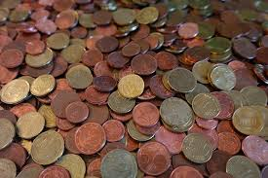
MARKETING ACTIVITIES - EXAMPLES
advertising
sales promotion
pricing
market research
developing new products
testing new products

Slide 6
BCG MATRIX
developed by The Boston Consulting Group in 70´s
it compares relative market share (cash generation) and market growth rate (cash usage) – it divides products based on these indicators into four sections:
  Cash cows
  Stars
  Question Marks (Problem Child)
  Dogs

Slide 7
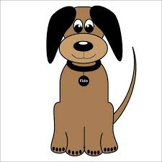
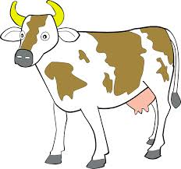
BCG MATRIX - CONTINUATION
RELATIVE MARKET SHARE
MARKET GROWTH RATE
?

Slide 8
MARKETING MIX
The set of activities which a company use to strengthen demand for its products.
It consits of:
  Product
  Place
  Price
  Promotion
Sometimes we speak about 8 Ps – marketing mix includes other Ps - Packaging, Positioning, People, Partnership.
We speak about 4 Ps

Slide 9





PRODUCT
It´s all that can be sold, offered or exchanged.
It isn´t just material thing (car, toothbrush, oranges, house), but it can also be immaterial thing (idea, know-how, licence).
SCHOOL

Slide 10



PLACE
How the goods get from the producer to the customer.

Slide 11

PRICE
The amount that you pay for a definite quantity, weight or other measure of a good or service.

Slide 12
PROMOTION
Tools used for persuasive communication with customers:
      advertising
      personal selling
      sales promotion
      public relations

Slide 13
THE OTHER Ps
Packaging – putting goods into the wrappers, designing and of these wrappers
Positioning – the way by which the marketers want to create required impression in the minds of consumers
People – work of employees, management, organization culture
Partnership – cooperations and alliances

Slide 14
Resources:
http://www.notesdesk.com/notes/marketing/what-is-marketing-and-basic-marketing-concepts/
http://en.wikipedia.org/wiki/Marketing#History
http://esl.about.com/od/businessenglishvocabulary/a/lx_marketing1.htm
http://www.netmba.com/strategy/matrix/bcg/
http://economictimes.indiatimes.com/definition/marketing-mix
www.pixabay.com

