Slide 1

PRIMATES
Výukový materiál OR 03 - 81
Tvůrce: Mgr. Alena Výborná
Tvůrce anglické verze: Mgr. Miloslava Dorážková
Projekt: S anglickým jazykem do dalších předmětů
Registrační číslo: CZ.1.07/1.1.36/03.0005
Tento projekt je spolufinancován ESF a SR ČR

Slide 2
PRIMATES
A very important group of mammals
There are:
  Prosimians
  Monkeys
  Apes
  A man
Flat nails are one of the typical features
Herbivores, omnivores, insectivores

Slide 3
PRIMATES - PROSIMIANS
Africa, Asia
Most of them are nocturnal animals
They have big eyes
Lemur catta
  Madagascar
  A herbivore
  Endangered

Slide 4
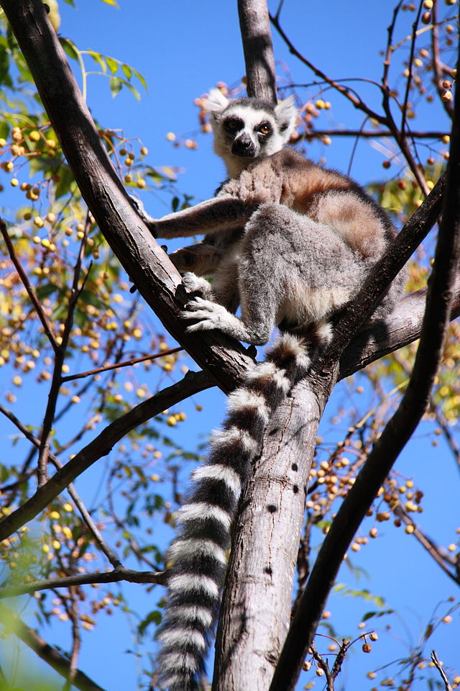
Lemur catta

Slide 5
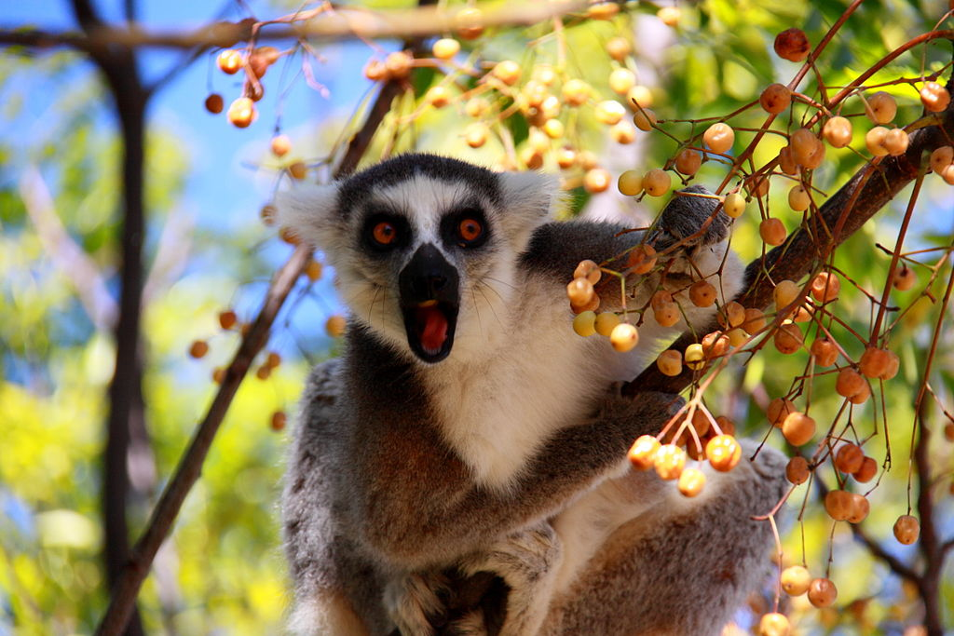

Slide 6
PRIMATES - PROSIMIANS
Bushbaby
  Small species with big eyes and ears
  Long back legs
  They use long jumps for the movement
  They eat insects and small vertebrates

Slide 7
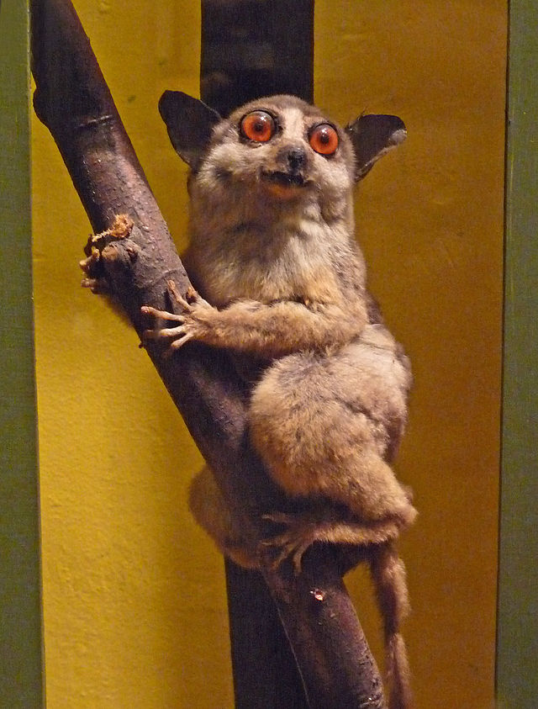
Bushbaby

Slide 8
PRIMATES – MONKEYS AND APES
Guenons
  They live in Africa, in the south from Sahara
  Most of them live in trees
  A long tail
  Old growth forests species are colourful
Macaque rhesus
  It used to be an animal for laboratory experiments

Slide 9
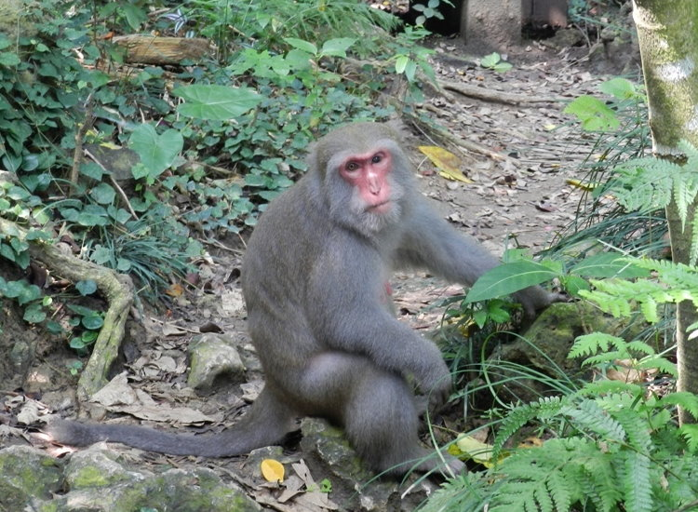
Macague rhesus

Slide 10
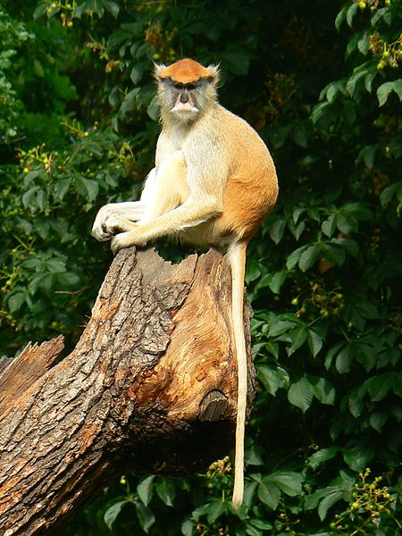
Guenon

Slide 11
PRIMÁTI – MONKEYS AND APES
Baboons
Monkey with a long face
Africa and the southern part of Arabian peninsula
Males are much bigger than females

Slide 12
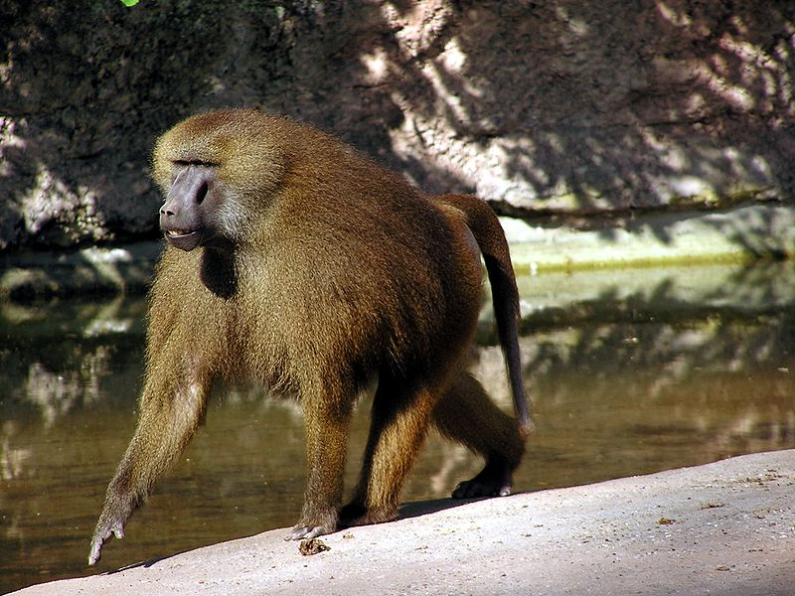
Baboon

Slide 13
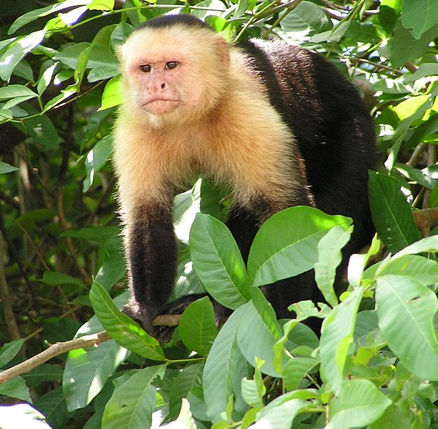
PRIMÁTI – MONKEY AND APES
Sapajous
High intelligence

Slide 14
PRIMATES – APES
They are big
They are tailess
Endangered
Chimpanzee (endangered critically)
Gorilla (endangered critically)
Orangutang (Asian old growth forests)
Gibbon

Slide 15
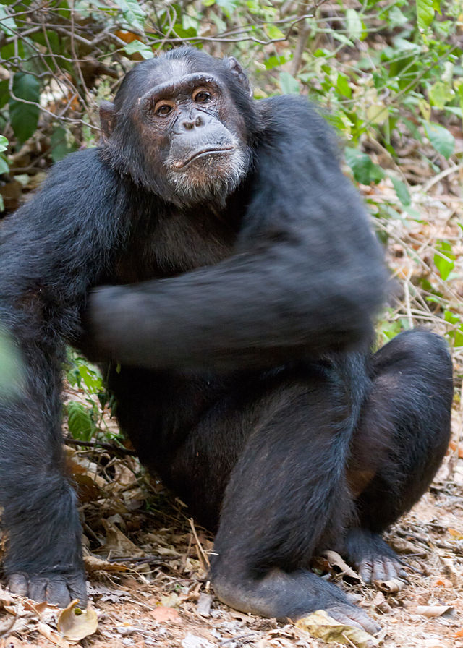
Chimpanzee

Slide 16
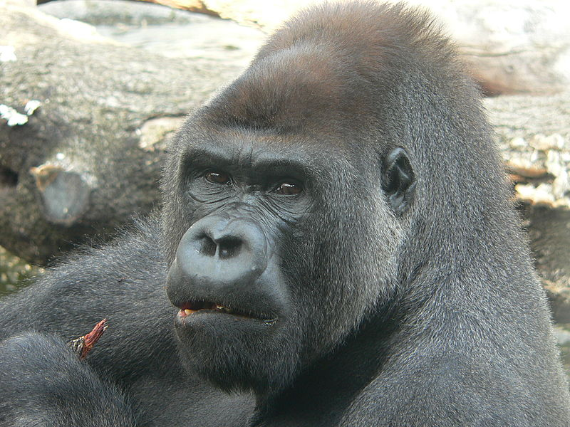
Gorilla

Slide 17
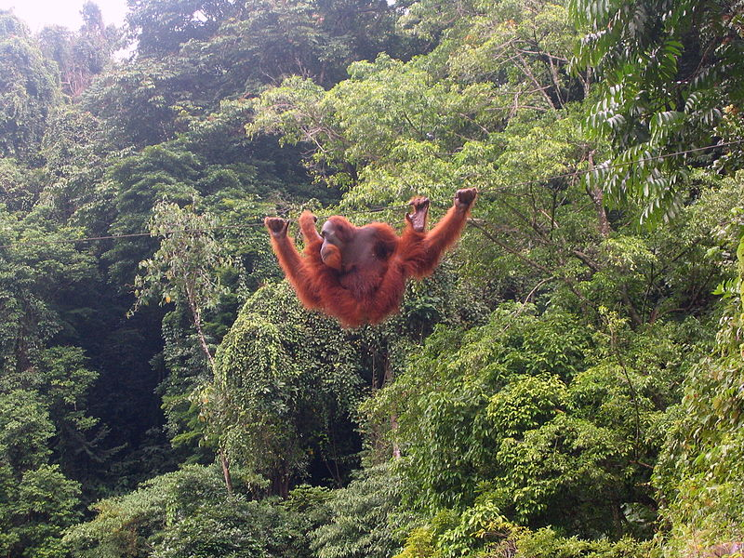
Orangutang

Slide 18
REVISION:
1) What is the main feature of primates?
2) Where do prosimians live?
3) An endangered prosiminian with big eyes which uses jumps to move is called:
4) A monkey with a long face is:
5) What apes occur in Asian old growth forests?

Slide 19
Zdroj
DOBRORUKA, Luděk J. Přírodopis pro 7. ročník základní školy. 1. vyd. Praha: Scientia, 1998, 152 s. ISBN 80-718-3134-4
Obrázky: http://commons.wikimedia.org (osvobozeno od autorských práv)

