Slide 1

INSECTIVORES AND CHIROPTERANS
Výukový materiál OR 03 - 80
Tvůrce: Mgr. Alena Výborná
Tvůrce anglické verze: Mgr. Miloslava Dorážková
Projekt: S anglickým jazykem do dalších předmětů
Registrační číslo: CZ.1.07/1.1.36/03.0005
Tento projekt je spolufinancován ESF a SR ČR

Slide 2
INSECTIVORES
Small sized mammals
A different shape of the
A big amount of teeth

Slide 3
INSECTIVORES
A hedgehog is our best-known insectivore
  In danger it curls into a ball
  It buries into leaves and leaf mold for winter
  It starts its winter sleep in September – October
  There are two types of hedgehogs in the Czech Republic

Slide 4
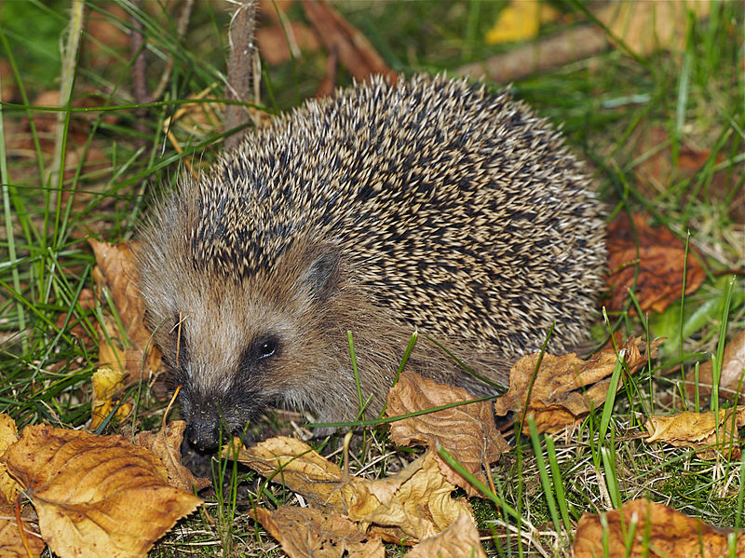
INSECTIVORES – a hedgehog

Slide 5
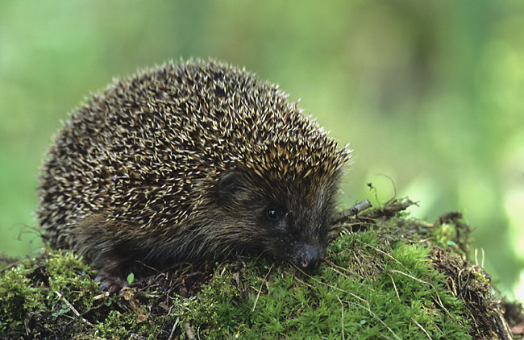
INSECTIVORES – a hedgehog

Slide 6
HMYZOŽRAVCI
A mole is adapted excellently for underground life
  Front legs are massive, shovel shaped
  It has strong claws
  It digs corridors
  It pushes the spare soil up to the surface - molehills

Slide 7
HMYZOŽRAVCI
Shrews
They are similar to mice
They have a long pointed muzzle
A common shrew is the largest group of shrews in the Czech Republic
A pygmy shrew – the smallest mammal in the Czech Republic

Slide 8
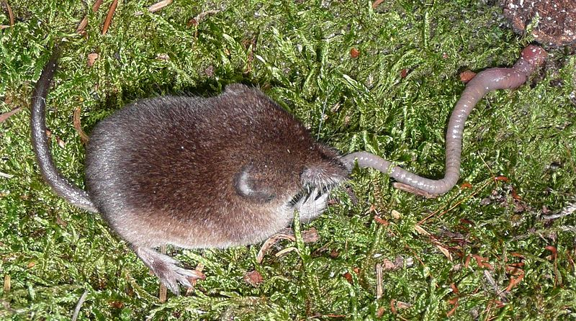
INSECTIVORES- a shrew

Slide 9
CHIROPTERANS
They can fly actively
The skeleton of the forelimbs is changed into wings
Bats
Horseshoe bats
Fruit bats

Slide 10
CHIROPTERANS
BATS AND HORSESHOE BATS
They eat insects
They are active at night
There are 24 species of bats and 2 species of horseshoe bats in the Czech Republic
They use bounced ultrasonic signals for the orientation
= ECHOLOCATION
Fruit bats
They do not occur in the Czech Republic
They are herbivores
They live mainly in the tropics

Slide 11
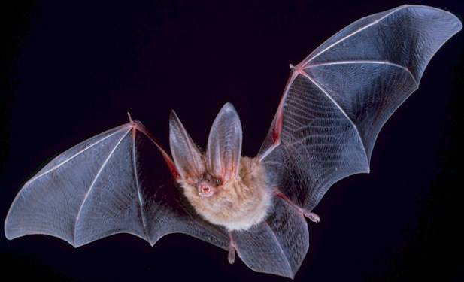
CHIROPTERANS – a bat

Slide 12
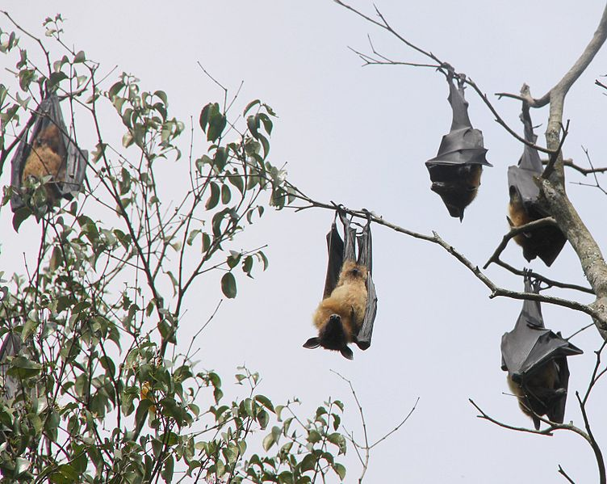
CHIROPTERANS – fruit bats

Slide 13
REVISION:
1) How does a hedgehog survive winter?
2) An insectivore, which lives underground, is called:
3) Our smallest mammal is:
4) Herbivores which belong to the chiropterans are called:
5) How is the way of communication and orientation of bats called?

Slide 14
Sources:
DOBRORUKA, Luděk J. Přírodopis pro 7. ročník základní školy. 1. vyd. Praha: Scientia, 1998, 152 s. ISBN 80-718-3134-4
Obrázky: http://commons.wikimedia.org (osvobozeno od autorských práv)

