Slide 1

RODENTS AND HARES
Výukový materiál OR 03 - 79
Tvůrce: Mgr. Alena Výborná
Tvůrce anglické verze: Mgr. Miloslava Dorážková
Projekt: S anglickým jazykem do dalších předmětů
Registrační číslo: CZ.1.07/1.1.36/03.0005
Tento projekt je spolufinancován ESF a SR ČR

Slide 2
RODENTS AND HARES
Small mammals
The set of teeth is the common feature
The only pair of incisors is changed into gnaws teeth
  They do not have roots
  They grow up permanently
  The back part has very soft enemal
Herbivores, omnivores
A very large group of mammals

Slide 3
RODENTS AND HARES
Red squirrel
Its colour is in all shades from bright red to black
It always has a white belly
The babies can be coloured differently in one litter
An omnivore

Slide 4
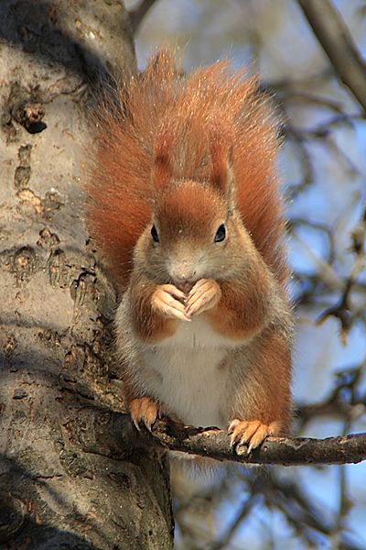
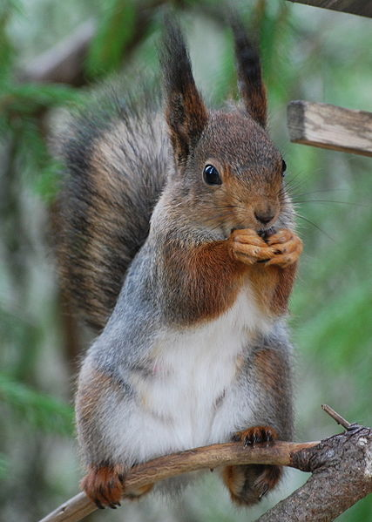
RODENTS – red squirrel

Slide 5
RODENTS AND HARES
European suslik
An inhabitant of steppes
In the fields and in the fallow lands in our country
It is endangered critically and protected by law
An omnivore

Slide 6
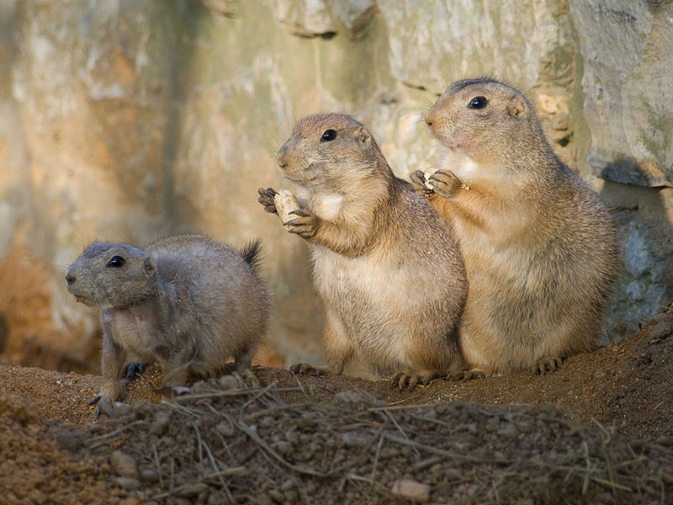
RODENTS – European suslik

Slide 7
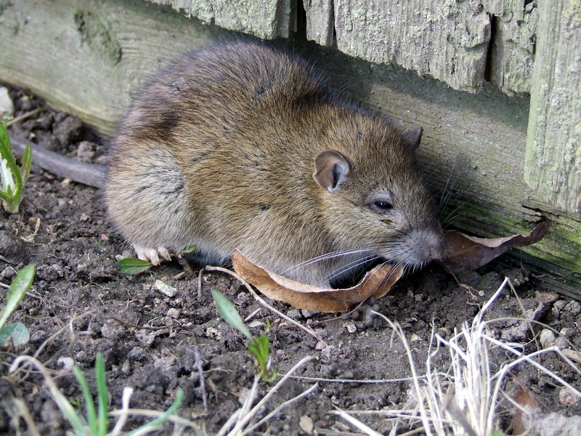
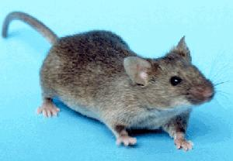
RODENTS – mouse and sewer-rat

Slide 8
HLODAVCI A ZAJÍCI
House mouse
It lives close to a man
It is spread all over the world
Sewer-rat
It is spread all over the world because of the shipping
Humid places – canals, sewers
They are transmitters of serious diseases

Slide 9
RODENTS AND HARES
Field mouse
Vegetable food
Earth dog
Vegetable food, insects, small mollusks
Water-rat
It gnaws roots of small young trees
It eats tubers, bulbs and destroys vegetables in the garden beds

Slide 10
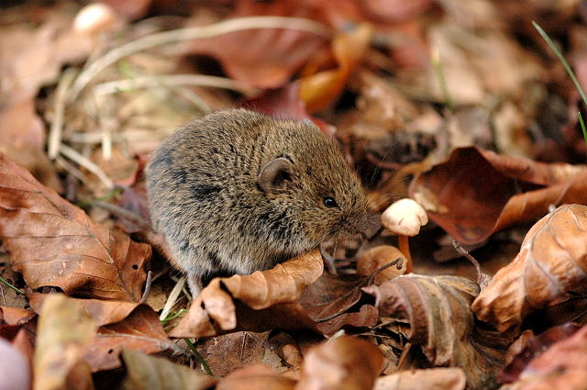
HLODAVCI – bank vole

Slide 11
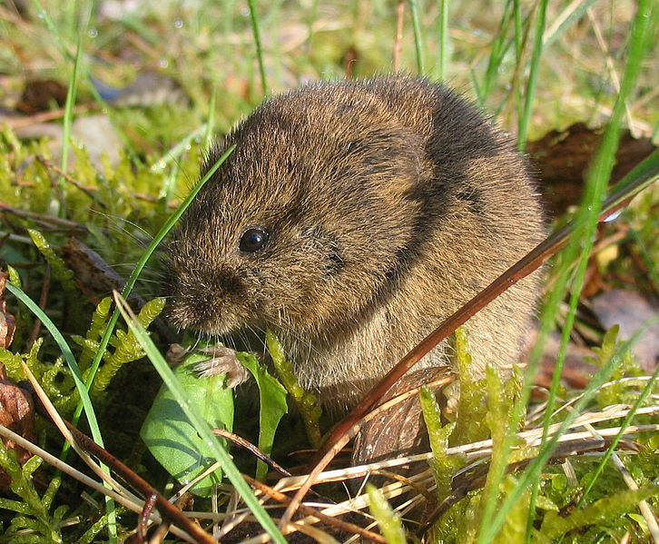
RODENTS – field mouse

Slide 12
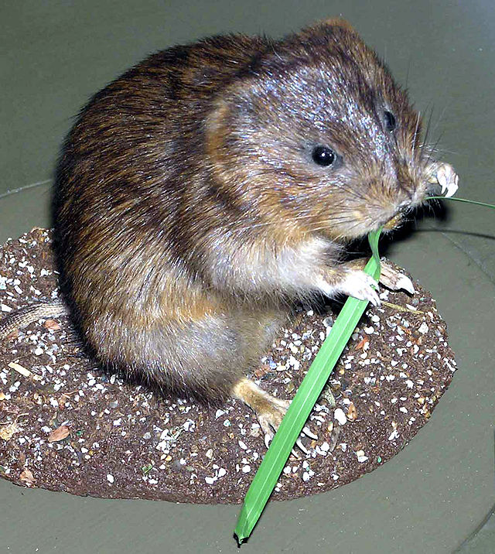
RODENTS – water-rat

Slide 13
HLODAVCI A ZAJÍCI
Hamsters
A dumpy body
Short legs, a short tail
Common hamster
It is active at night
It lives in fields and meadows
It digs deep holes
It carries supplies of grains in its cheeks

Slide 14
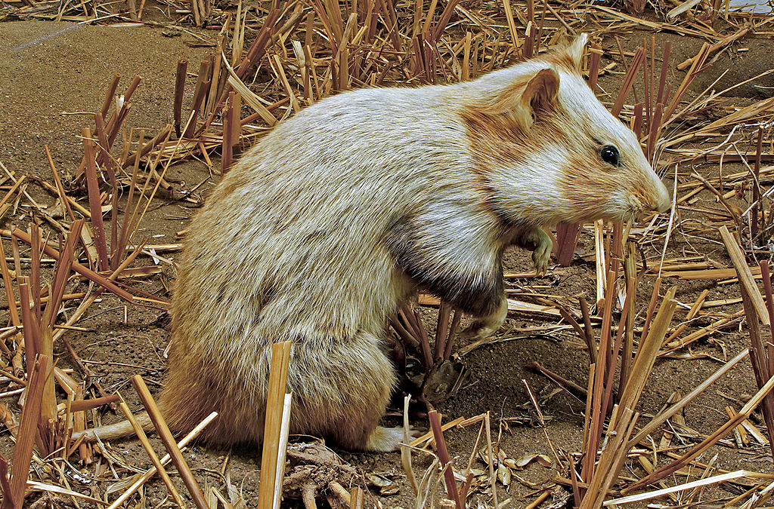
RODENTS – common hamster

Slide 15
RODENTS AND HARES
Hares are similar to rodents
They have 2 bigger incisors in the upper jaw and 2 smaller incisors behind them, both are similar to gnaws teeth
Brown hare
Tame rabbit

Slide 16
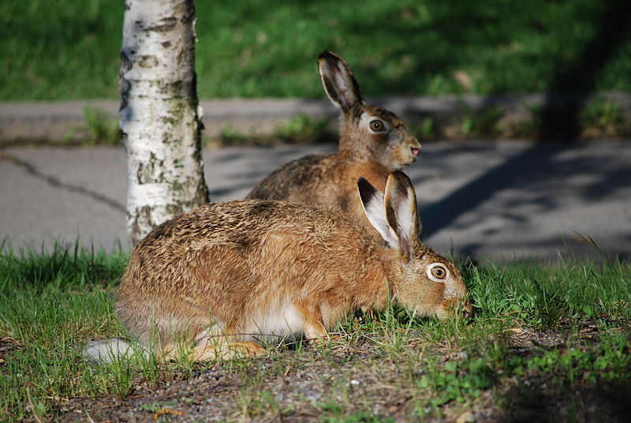
HARES – brown hare

Slide 17
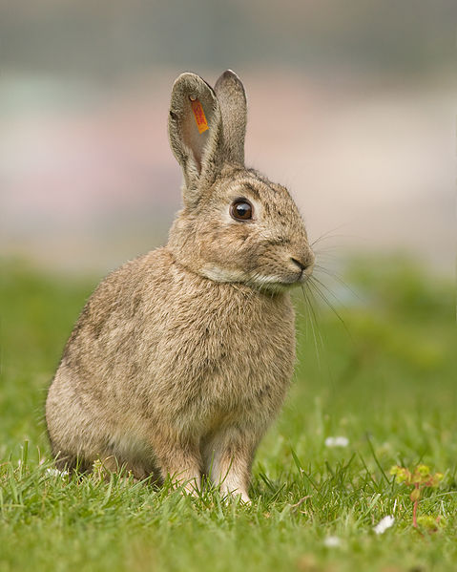
HARES – tame rabbit

Slide 18
REVISION:
1) What is the typical feature of rodents?
2) ………..is an inhabitant of steppes.
3) ………..is a transmitter of serious diseases.
4) Where does a hamster carry the supplies of grains?
5) Do hares have the same set of teeth like rodents?

Slide 19
Sources:
DOBRORUKA, Luděk J. Přírodopis pro 7. ročník základní školy. 1. vyd. Praha: Scientia, 1998, 152 s. ISBN 80-718-3134-4
Obrázky: http://commons.wikimedia.org (osvobozeno od autorských práv)

