Slide 1

VIVIPAROUS
Výukový materiál OR 03 - 78
Tvůrce: Mgr. Alena Výborná
Tvůrce anglické verze: Mgr. Miloslava Dorážková
Projekt: S anglickým jazykem do dalších předmětů
Registrační číslo: CZ.1.07/1.1.36/03.0005
Tento projekt je spolufinancován ESF a SR ČR

Slide 2
VIVIPAROUS
They appeared about 100 million years ago
We divide them into:
  Marsupials
  Placental mammals
Both these groups were developed separately

Slide 3
VIVIPAROUS
Mammals are distinguished by these features:
  1) Stable body temperature
  2) The body is covered by fur consisted of hairs
    Guard hairs (tough)
    Underfur (soft)
    Tactile hairs
    Fur change = moulting
  3) Mammary glands
  4) Jaws have teeth
  5) They breathe by lungs

Slide 4
VIVIPAROUS - marsupials
They deliver imperfectly developed young ones
The other development of young ones takes place in a pouch on the belly
Inside of the pouch there are milk nipples and a young attaches to them
Milk is injected into the mouth of the young several times
They live in Australia and South America

Slide 5
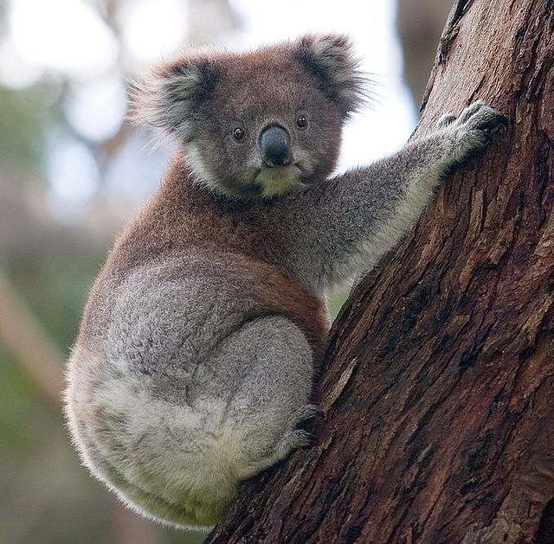
VIVIPAROUS marsupials
A koala
A common opossum
A southern marsupial mole
A Tasmanian wolf
A greater glider
Kangaroos

Slide 6
Koala
An Australian marsupial
The fingers on the forelimbs are grown together
They live in trees
A food specialist – leaves of eucalyptus

Slide 7
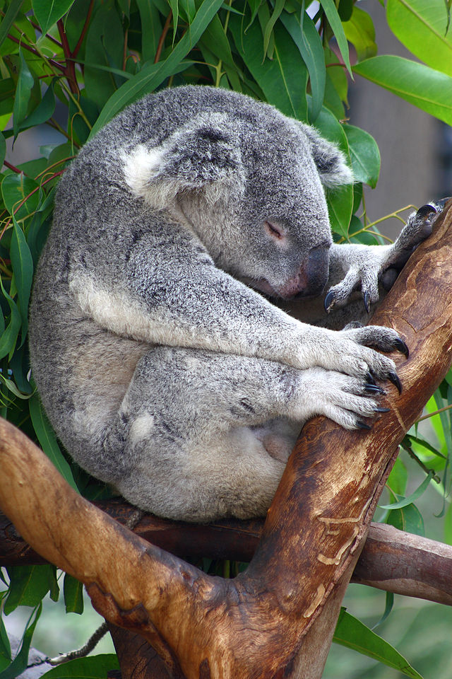
Koala

Slide 8
Kangaroo
They live in Australia
They have strong hind-limbs
They make big jumps thanks to the hind-limbs
They use a strong tail as a support
Herbivores

Slide 9
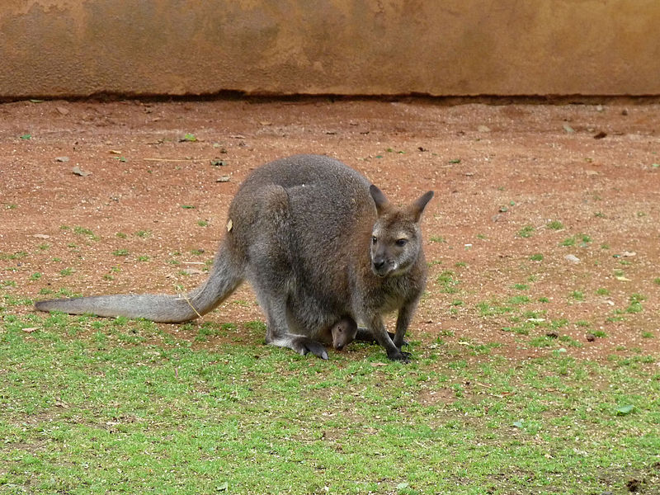
Kangaroo

Slide 10
A southern marsupial mole and a greater glider
A southern marsupial mole
Sand areas
It looks like a mole
A greater glider
Among limbs and sides there is a special skin membrane covered by fur
Sliding flight

Slide 11
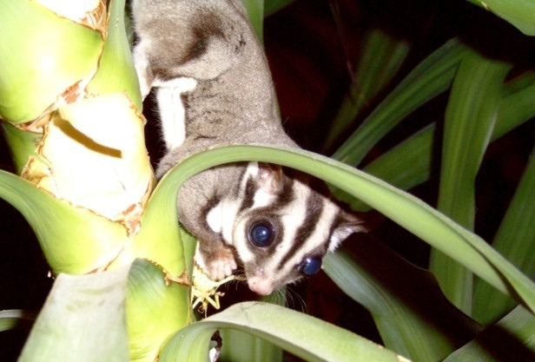
A sugar glider

Slide 12
VIVIPAROUS - placentalia
An embryo is developed in the mother´s body
It is nourished by placenta
The babies are born developed
They are fed by breast milk which they suck
Their species are larger than marsupials

Slide 13
VIVIPAROUS - placentalia
Insectivora
Chiroptera
Primates
Rodentials
Hares
Felines
Pinnipedians
Proboscidea
Perrisodactyle
Artiodactyls
Cetaceans

Slide 14
REVISION:
1) …………mammals are nourished thanks to placenta.
2) When did the first viviparous appear?
3) The food specialist is:
4) The mammals fur exchange is called:
5) Do marsupials suck breast milk?

Slide 15
Sources:
DOBRORUKA, Luděk J. Přírodopis pro 7. ročník základní školy. 1. vyd. Praha: Scientia, 1998, 152 s. ISBN 80-718-3134-4
Obrázky: http://commons.wikimedia.org (osvobozeno od autorských práv)

