Slide 1

BIRDS
Výukový materiál OR 03 - 76
Tvůrce: Mgr. Alena Výborná
Tvůrce anglické verze: Mgr. Miloslava Dorážková
Projekt: S anglickým jazykem do dalších předmětů
Registrační číslo: CZ.1.07/1.1.36/03.0005
Tento projekt je spolufinancován ESF a SR ČR

Slide 2
BIRDS
In the Mesozoic era from reptiles
archeopteryx – has features of both birds and reptiles
The stable body temperature
Forelimbs were changed into wings
The body was covered by feathers (movement, warmth)

Slide 3
BIRDS
FEATHERS:
Vane feathers (cover feathers which protect the body, the neck and the head – remixes and steering feathers)
Down feathers (under the vane feathers, make insulation)
Filoplume feathers
Follicle feathers – places where the feathers grow
Naked places (the down feathers can be here)

Slide 4
A – vane
B – feathers detail
C – downy feathers

Slide 5
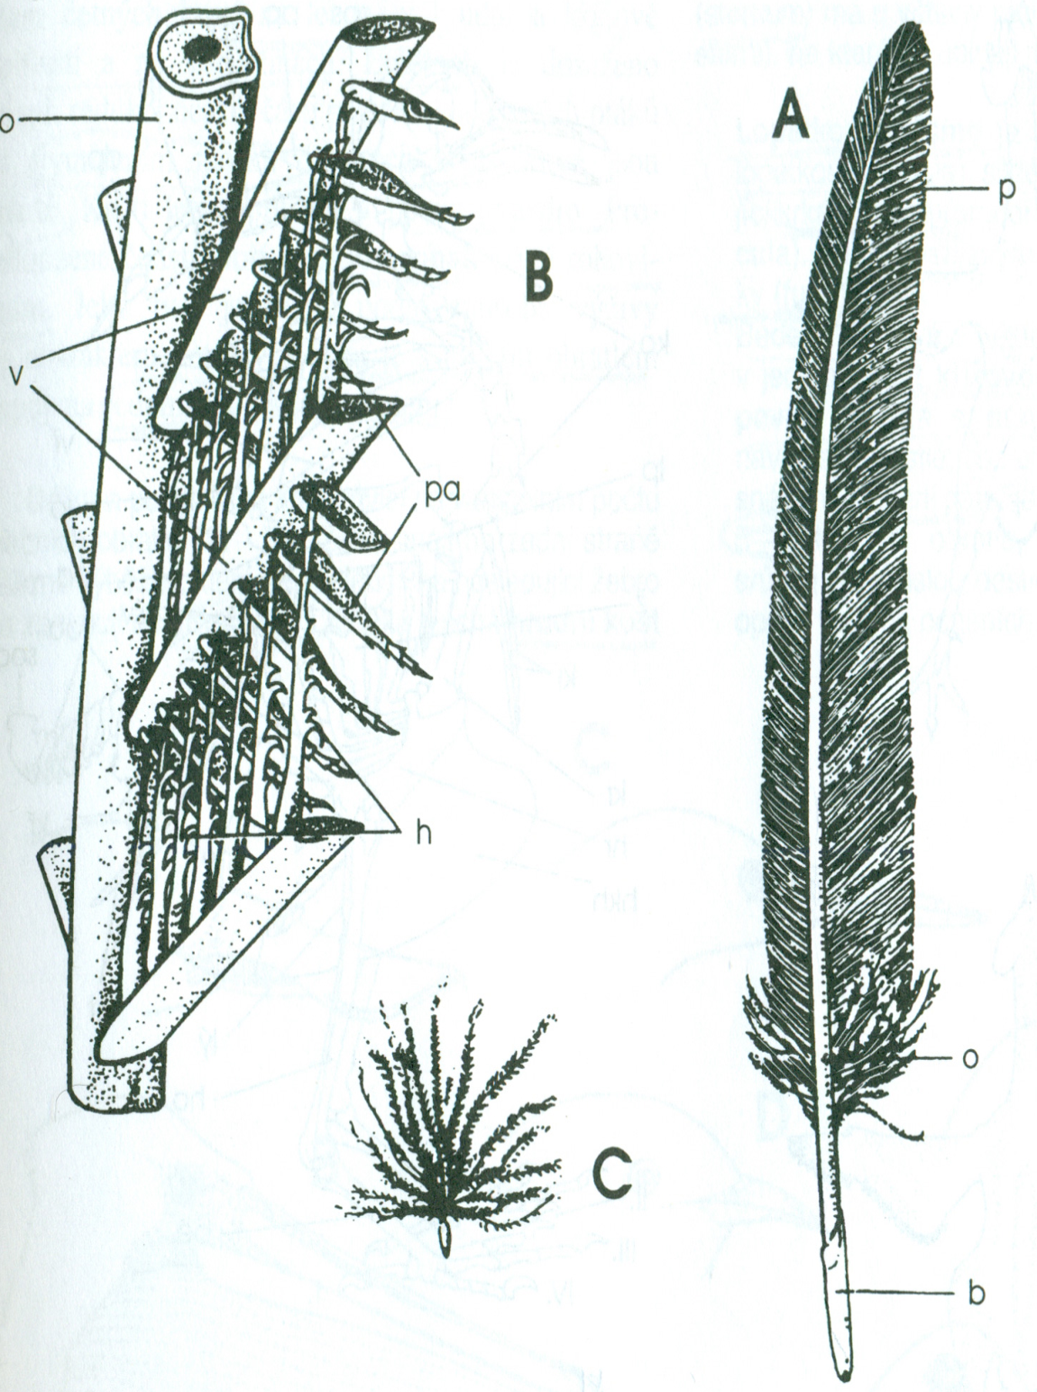
A – VANE
p – barb
o – afterfeathers
b – hollow shaft
B- VANE DETAIL
pa – hooklets
v – barbules
C – DOWNY FEATHERS

Slide 6
BIRDS
Moulting – feather exchange
Prolonged jaws changed into a beak covered by keratin
On the breastbone there was a carina developed – massive flying muscles are attached to it
Skeleton – light, hollow bones
Air bags (connected to the lungs) – adapted to fly
Lungs – small

Slide 7
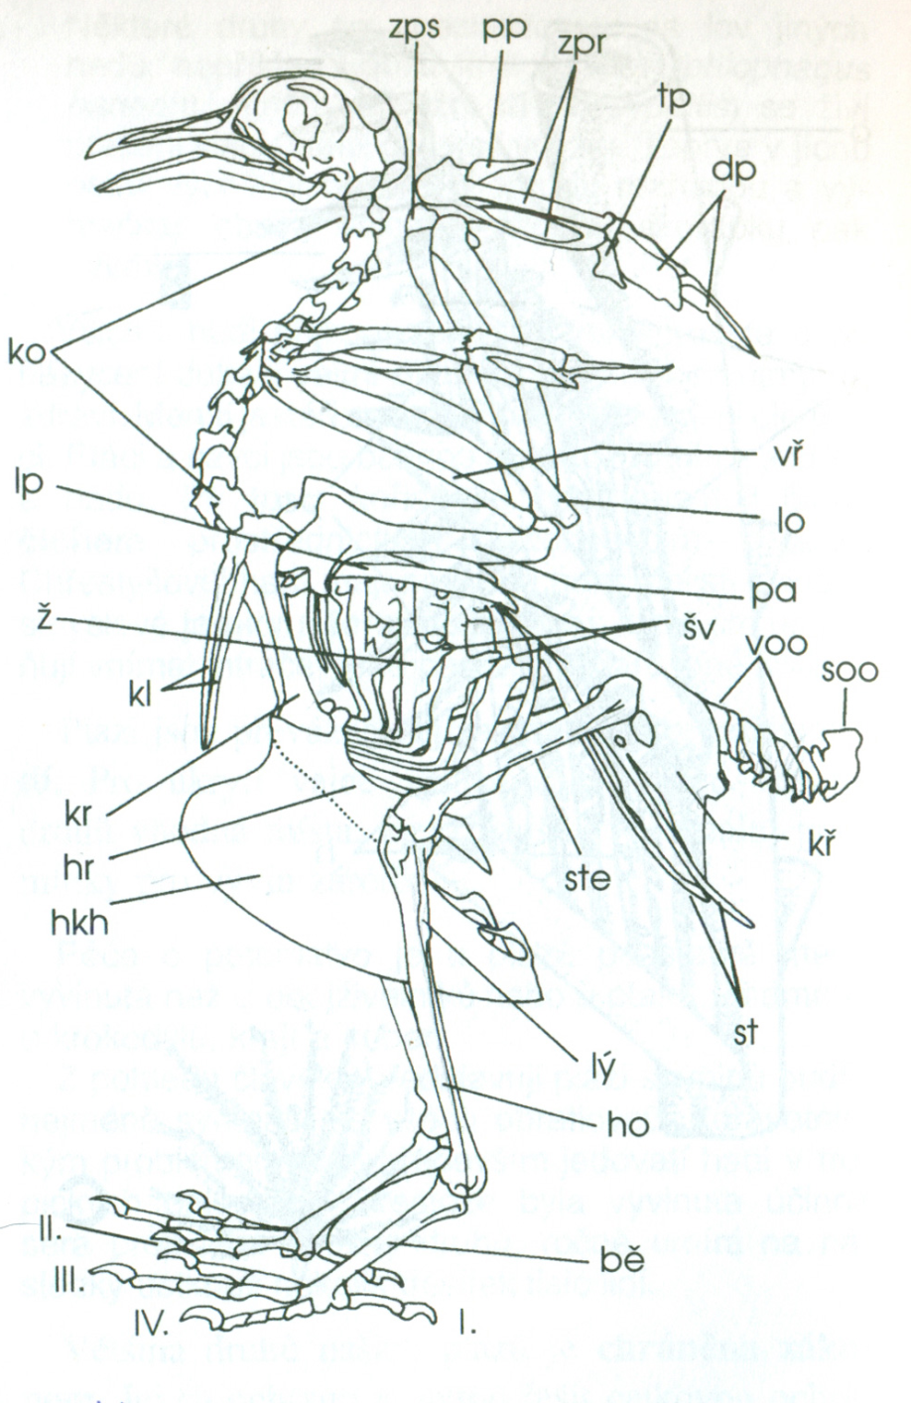
BIRDS - skeleton
bě – tarsometatarsus
hkh – keeled sternum
soo – knitted tail vertebrae

Slide 8
BIRDS
They have perfect sight (colourful seeing), eyes are movable a little, not at all by owls. Penguins, cormorants and seagulls have movable eyes.
Eyes are protected by three pairs of eyelids (lower and upper ones and a winking membrane)
Perfect hearing (the best by owls)
Relatively well developed smell by some of them – a kiwi bird, a condor, a duck, a pigeon

Slide 9
BIRDS
Digestive, excretory and reproductive systems lead into a cloaca
Bird urine goes smoothly into a cloaca
The body temperature with birds is 42 degrees (38 – 42)
They lay eggs
Period of reproduction – nesting
They look after the young ones differently

Slide 10
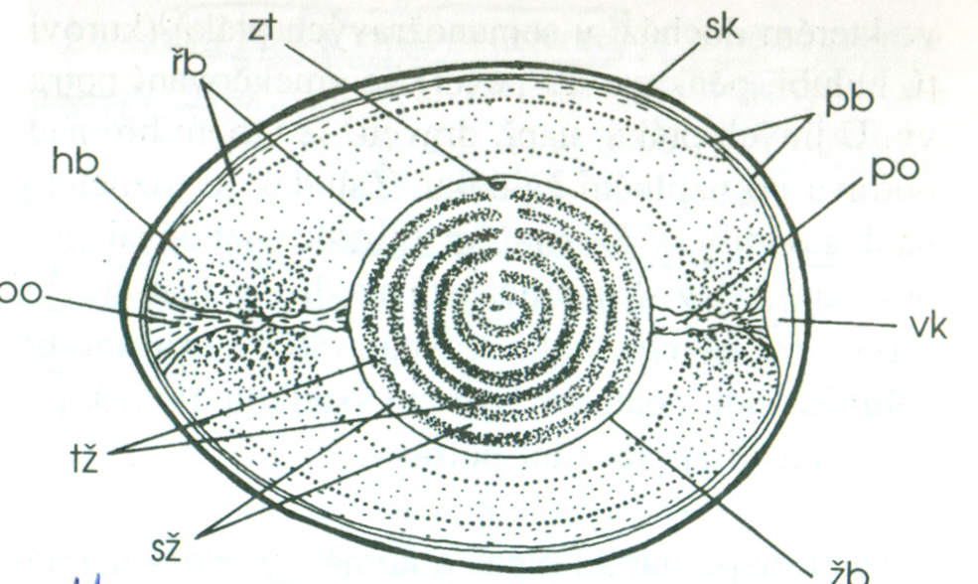
bb – thick albumen, řb – thin albumen, pb – shell membrane, po – chalaza, sk - shell, sž – bright yolk, tž – dark yolk, vk – air cell, zt – germinal disc, žb – yolk membrane

Slide 11
BIRDS
Feeding birds (a swallow, a sparrow, a blackbird) – young birds are blind, bare, powerless
Unfeeding birds (a pheasant, a partridge, a duck) – young birds are sighted, feathered, they are able to find food immediately after the hatching
egg tooth – breaks the shell, it falls away after the hatching

Slide 12
BIRDS
They are a very large and diverse group
The are settled all round the world
In the tropics – especially in old growth forests
Occurrence:
South America, west Africa, the colder climate the less species, they are the only vertebrates which get into the centre of Antarctica

Slide 13
BIRDS
Forelimbs:
The forelimbs are changed into wings, they aborted with some species
They are used mostly for flying, with penguins they are changed into fin wings
Hind-limbs:
Adapted for running, walking on different bases, for movement on the branches, hanging on rock walls, movement in water or hunting

Slide 14
BIRDS
Beak:
It is used for filtering of small of bigger organisms, fishing, hunting insects, sucking flower nectar, cutting out larvae of insects from the wood, eating fruits, cracking seeds or tearing meat

Slide 15
BIRDS
Bird behaviour:
It is managed mainly by instincts
They learn during the life and the instincts become better
Making pairs (courting):
It is connected with a special type of behaviour = utter the mating call
Males attract by different signals (voice, movement, postures)
Females inform how they are prepared for the coupling

Slide 16
BIRDS
Features during reproduction are very diverse
Engage flights (birds of prey), dances, colouring
Nesting:
Females or males or both choose the place for the nest
Both build the nest or the female builds and the male brings material

Slide 17
BIRDS
Some of them do not build nests and lay eggs on the ground or use deserted nests of other birds
Nest parasitism = whole nest care is transferred to a different bird species (a cuckoo)

Slide 18
BIRDS
Nest territories:
They are occupied by males just before making the couple and they protect them (themselves, later with the female)
They occupy them with singing, postures (a robin)
Bird migration: (flights)
They move for better conditions and food

Slide 19
BIRDS
From the point of migration we distinguish three groups of birds:
1) Stable birds: whole year at the same place
a house sparrow, a grey partridge, a magpie)
2) Migratory birds: they wander around larger area (100 –500 km)
a tit, a goldfinch, a greenfinch, a rook
3) Birds of passage: they make long flights twice a year
a starling, a swallow, a stork, a cuckoo, a wagtail, a swift

Slide 20
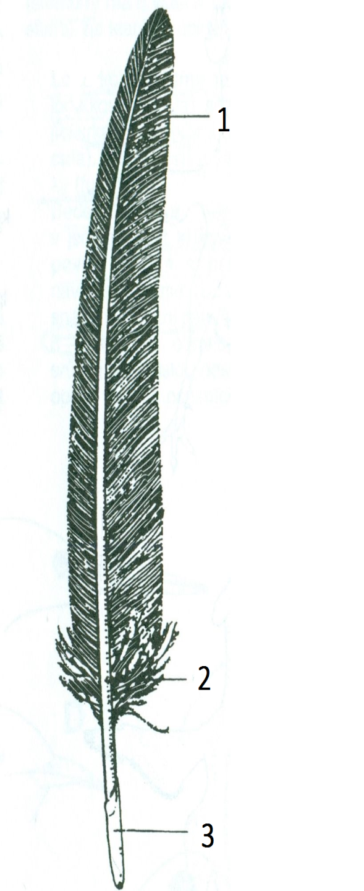
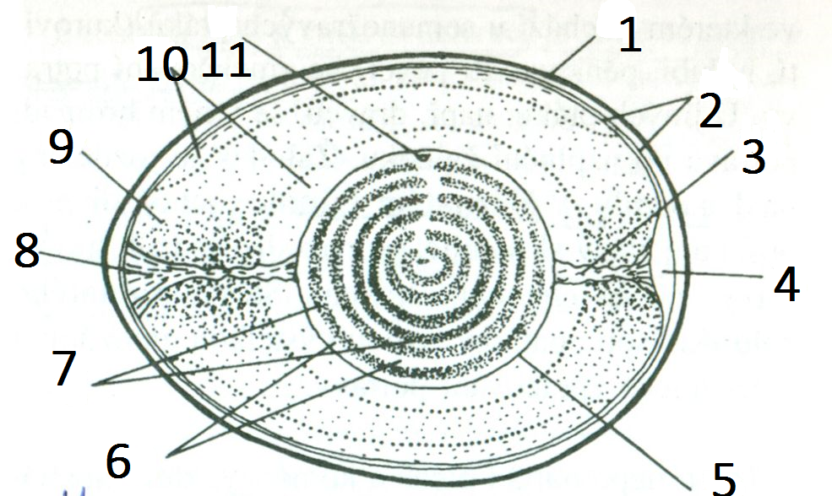
REVISION:
Describe the pictures

Slide 21
Source:
DOBRORUKA, Luděk J. Přírodopis pro 7. ročník základní školy. 1. vyd. Praha: Scientia, 1998, 152 s. ISBN 80-718-3134-4

