Slide 1

HELMINTHS
Výukový materiál OR 03 - 68
Tvůrce: Mgr. Alena Výborná
Tvůrce anglické verze: Mgr. Miloslava Dorážková
Projekt: S anglickým jazykem do dalších předmětů
Registrační číslo: CZ.1.07/1.1.36/03.0005
Tento projekt je spolufinancován ESF a SR ČR

Slide 2
HELMINTHS
A rounded and oblong body
They are various in shape
A various type of life
Parasites
Freely living species

Slide 3
HELMINTHS – wheel animals
They are similar to big infusorians
0,5 – 2 mm
They live mainly in fresh waters
Some of them attach to objects
Some of them float
They make a solid case in unfavourable conditions
They have a retractable whirling apparatus on the foreground of the body
On the opposite side of the body there is a fork - movement

Slide 4
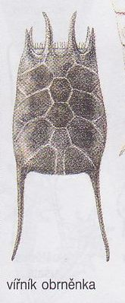
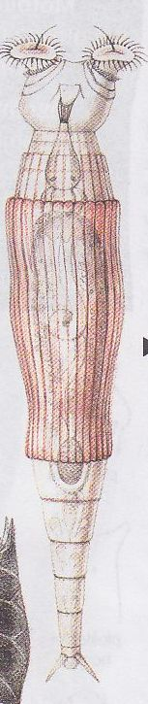
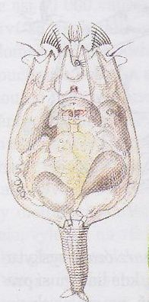
HELMINTHS - wheel animals
- dinoflagellate

Slide 5
HELMINTHS – THREAD WORMS
A rounded, elastic, oval body which is getting narrow to the ends
Parasites in the body of animals, plants and a man
Some of them live freely in soil (important)
Winegar worms
Pinworms
Roundworms

Slide 6
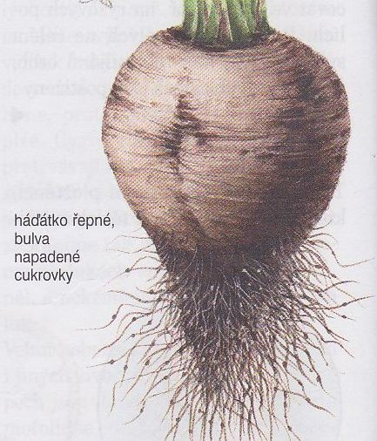
WINEGAR WORMS
Tiny
Parasites of plants
A sugar beet nematode
- a parasitized beetroot

Slide 7
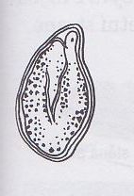
PINWORMS
Parasites of vertebrates and insects
A man – pinworms (especially by children)
  In a large intestine
  The females lay eggs around an anal orifice at night
  Itching
  They get into the body with food
  an egg of a pinworm

Slide 8
ROUNDWORMS
They are parasites in intestines of vertebrates
They damage the inside part of the intestine the intestinal wall and excrete poisonous substances
They cause:
Indigestions, headaches, vertigos, constipations, stomach aches, limbs paralyses

Slide 9
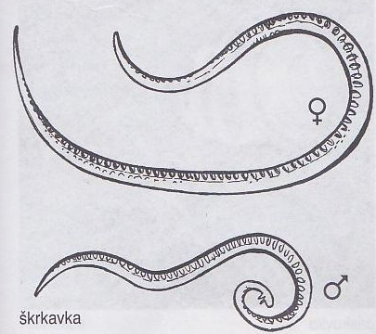
A roundworm

Slide 10
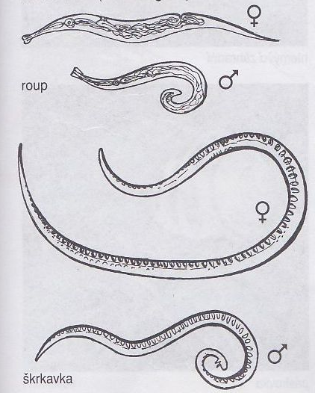
A pinworm
A roundworm

Slide 11
ROUNDWORMS
A roundworm (with children)
  10 cm
  It parasites by people
  From food (vegetables)
  Protection – following hygienic rules

Slide 12
ROUNDWORMS
A dog roundworm
  17 – 20 cm
  It parasites mainly by puppies up to 1 year
A parascaris equorum
  A female up to 50 cm, a male 25 cm

Slide 13
REVISION:
1) ………..parasites on plants.
2) ………..occurs in a group of children.
3) The biggest roundworm is….
4) Pinworms live in…
5) ……….are similar to big infusorians.

Slide 14
Source:
DOBRORUKA, Luděk J. Přírodopis pro 7. ročník základní školy. 1. vyd. Praha: Scientia, 1998, 152 s. ISBN 80-718-3134-4

