Slide 1

BACTERIA
Výukový materiál OR 03 - 62
Tvůrce: Mgr. Alena Výborná
Tvůrce anglické verze: Mgr. Miloslava Dorážková
Projekt: S anglickým jazykem do dalších předmětů
Registrační číslo: CZ.1.07/1.1.36/03.0005
Tento projekt je spolufinancován ESF a SR ČR

Slide 2
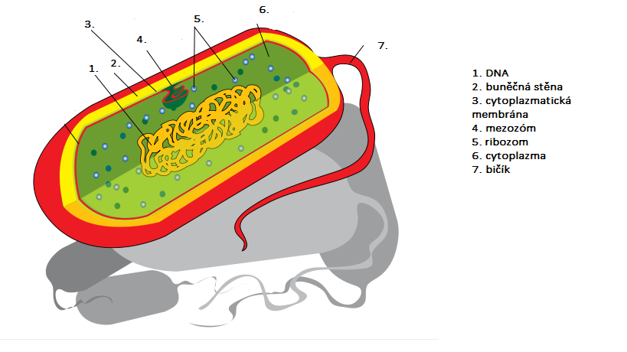
BAKTERIA – A CELL
1. DNA
2. Cell wall
3. Cytoplasm membrane
4. Mesosome
5. Ribosomes
6. Cytoplasm
7. Flagellum

Slide 3
BAKTERIA
Unicellular organisms
Cosmopolitan spreading (water, air, soil, human body)
Bacteriology = a science about bacteria
They have a diverse shape:
a) cocci
coca diplococcus steptococcus

Slide 4
BAKTERIA
Staphylococcus

Slide 5
BAKTERIA
b) bacilli
rod-shaped vibrio

Slide 6
BAKTERIA - REPRODUCTION
They use a cell division for the reproduction
Doubling time = the time period from one division to the other one
Spores:
They are resistant to high temperatures, radiation…
They are able to survive unfavourable conditions

Slide 7
BAKTERIA – RELATION TO THE OXYGEN
aerobic
They need air oxygen to live
anaerobic
They live without air oxygen

Slide 8
BAKTERIA – LIFE FORMS FORMY ŽIVOTA
Pathogenic bacteriae – cause illnesses
Saprophytic bacteriae – moulder and decompose substances
Symbiosis – symbionts of animals, a man

Slide 9
BAKTERIA - SYMBIOTIC
1. Lactobacillus – lactic acid production
2. Escherichia coli- in the man colon, provides K vitamin
3. Nodule bacteria – symbiosis with fabaceous plants, they enrich soil by nitrogen

Slide 10
BAKTERIA – INFECTIONS OF A MAN
Infections transmitted by air
1. Angina
Sore throat
Bigger nodes
2. Tuberculosis (TBC)
Incubation period : 6-8 weeks
It causes: disintegration of pulmonatory tissue

Slide 11
BAKTERIA – INFECTIONS OF A MAN
Infections transmitted by alimentary way:
Bacteria are excreted by urine or a stool
1. Salmonella
Incubation period 12 – 24 hours
Features: vomiting, diarrhoea
2. Cholera
Features: diarrhoea, temperature decrease
Incubation period 1 – 2 days

Slide 12
BAKTERIA – INFECTIONS OF A MAN
Infections transmitted through skin
Tetanus
Features: painful muscle contraction, up to mortal cramps
Incubation period 7 – 14 days
Reliable protection: vaccination

Slide 13
BAKTERIA – INFECTIONS OF A MAN
Infections transmitted by sex act
1. Syphilis
2. Gonorrhoea

Slide 14
BAKTERIA - IMPORTANCE
Decomposition – mineralization of organic substances (reducents, destruents, decompositors), mouldering
Symbionts
They cause illnesses of plants, animals and a man
They are used in biotechnologies (biogas production, sour milk products, alcohol, antibiotics, hormones, cleaning sewage waters…)

Slide 15
REVISION:
1) Can bacteria be profitable for us?
2) How is the bacterium which is found in the colon called?
3) How is the bacterium which causes angina transmitted?
4) How is this bacterium called ?

Slide 16
Sources:
DOBRORUKA, Luděk J. Přírodopis pro 7. ročník základní školy. 1. vyd. Praha: Scientia, 1998, 152 s. ISBN 80-718-3134-4
Obrázky: http://commons.wikimedia.org (osvobozeno od autorských práv)

