Slide 1

Food pyramid, food chain
Výukový materiál EK 01 - 22
Tvůrce: Ing. Marie Jiráková
Tvůrce anglické verze: Mgr. Milan Smejkal
Projekt: S anglickým jazykem do dalších předmětů
Registrační číslo: CZ.1.07/1.1.36/03.0005
Tento projekt je spolufinancován ESF a SR ČR

Slide 2
basic concepts
Abiotic conditions - are made ​​up of inanimate nature
Biotic conditions - are made ​​up of living nature
Population - the number of individuals of the same species living at the same time in the same place
Community – a set of all kinds of organisms living in a particular time at a particular place

Slide 3
Food relations in the community
The population in the community is bound to each other through food relations
We distinguish:
Producers
Consumers
Decomposers

Slide 4
Producers
Autotrophic organisms - green plants
Producers – they produce substances needed for other organisms

Slide 5
consumers
1-st order consumers - herbivores
higher order consumers - carnivores, predators

Slide 6
Decomposers
Destruents – saprophytic organisms–they feed on the bodies of dead organisms
Some decomposers are able to degrade complex organic compounds which serve as nutrients for a plant growth

Slide 7
food chain
Moving materials and energy among producers, consumers and decomposers is called a food chain
According to the type of organisms that contribute to the structure we distinguish:
Predatory food-chain (pasture)
Chain of decay (decomposition)

Slide 8
Examples of food chains
Plants (seeds, rhizomes, tubers, fruits) -herbivores (rodents, ungulates) - carnivores (weasel, fox, lynx)
The fallen leaves, plant residues - soil animals (earthworms, insects) - birds (blackbird, thrush) - birds of prey (owls, sparrow hawk, falcon)
Field crops (cereals, fodder) - cattle, pigs, poultry - a man

Slide 9
food web
Food relations are not simple linear chains, they are complex and intertwined – they form the food web

Slide 10
energy losses
Food chain or food web are the place of transmission of some substances and energy
When transferring food from organism to organism a part of the energy is wasted as unusable residual heat
The amount of transmitted energy in the food chain is gradually reduced – it forms the food pyramid

Slide 11
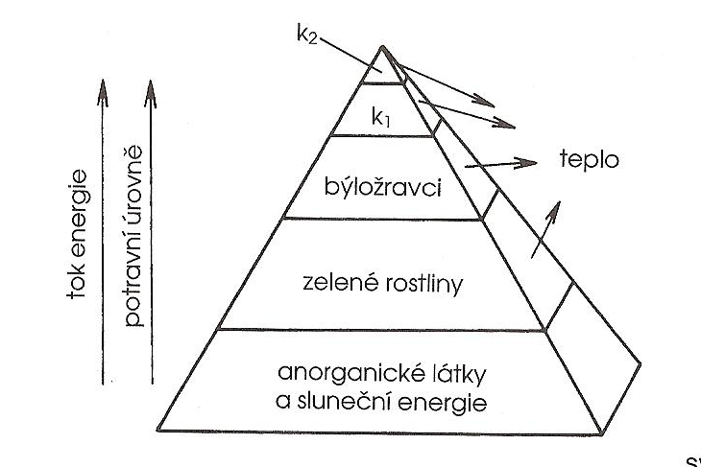
Food pyramid diagram
Notes:
Energy flow, food levels, herbivores, green plants, inorganic substances and solar energy, heat

Slide 12
Food pyramid and the concentration of pollutants
Each layer of the food pyramid provides less energy the higher layer than it has received from the lower layer
This regularity is the cause of increasing the concentration of pollutants
The more food is needed for a higher floor of the food pyramid, the more pollutants are stored in the body of the consumer

Slide 13
Worksheet - revision
Define the following terms: abiotic conditions, biotic conditions, population, community.
What types of food chains do you know?
Give an example of a real food chain.
Why is the concentration of pollutants in the upper floors of the food pyramid?

Slide 14
Sources
BRANIŠ, Martin. Základy ekologie a ochrany životního prostředí. 2. vyd. Praha: Informatorium, 1999. ISBN 80-86073-52-1.
KVASNIČKOVÁ, Danuše. Základy ekologie. Praha: Scientia,spol.s r.o., 1994, ISBN 80-85827-84-0

